Slide 1



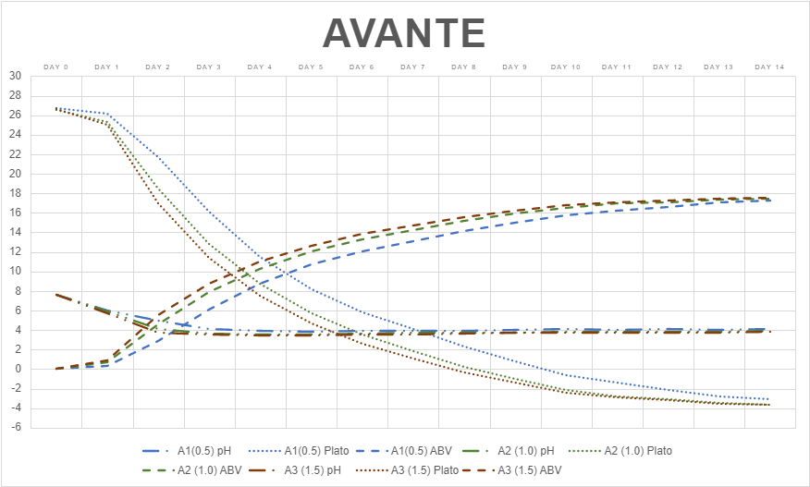
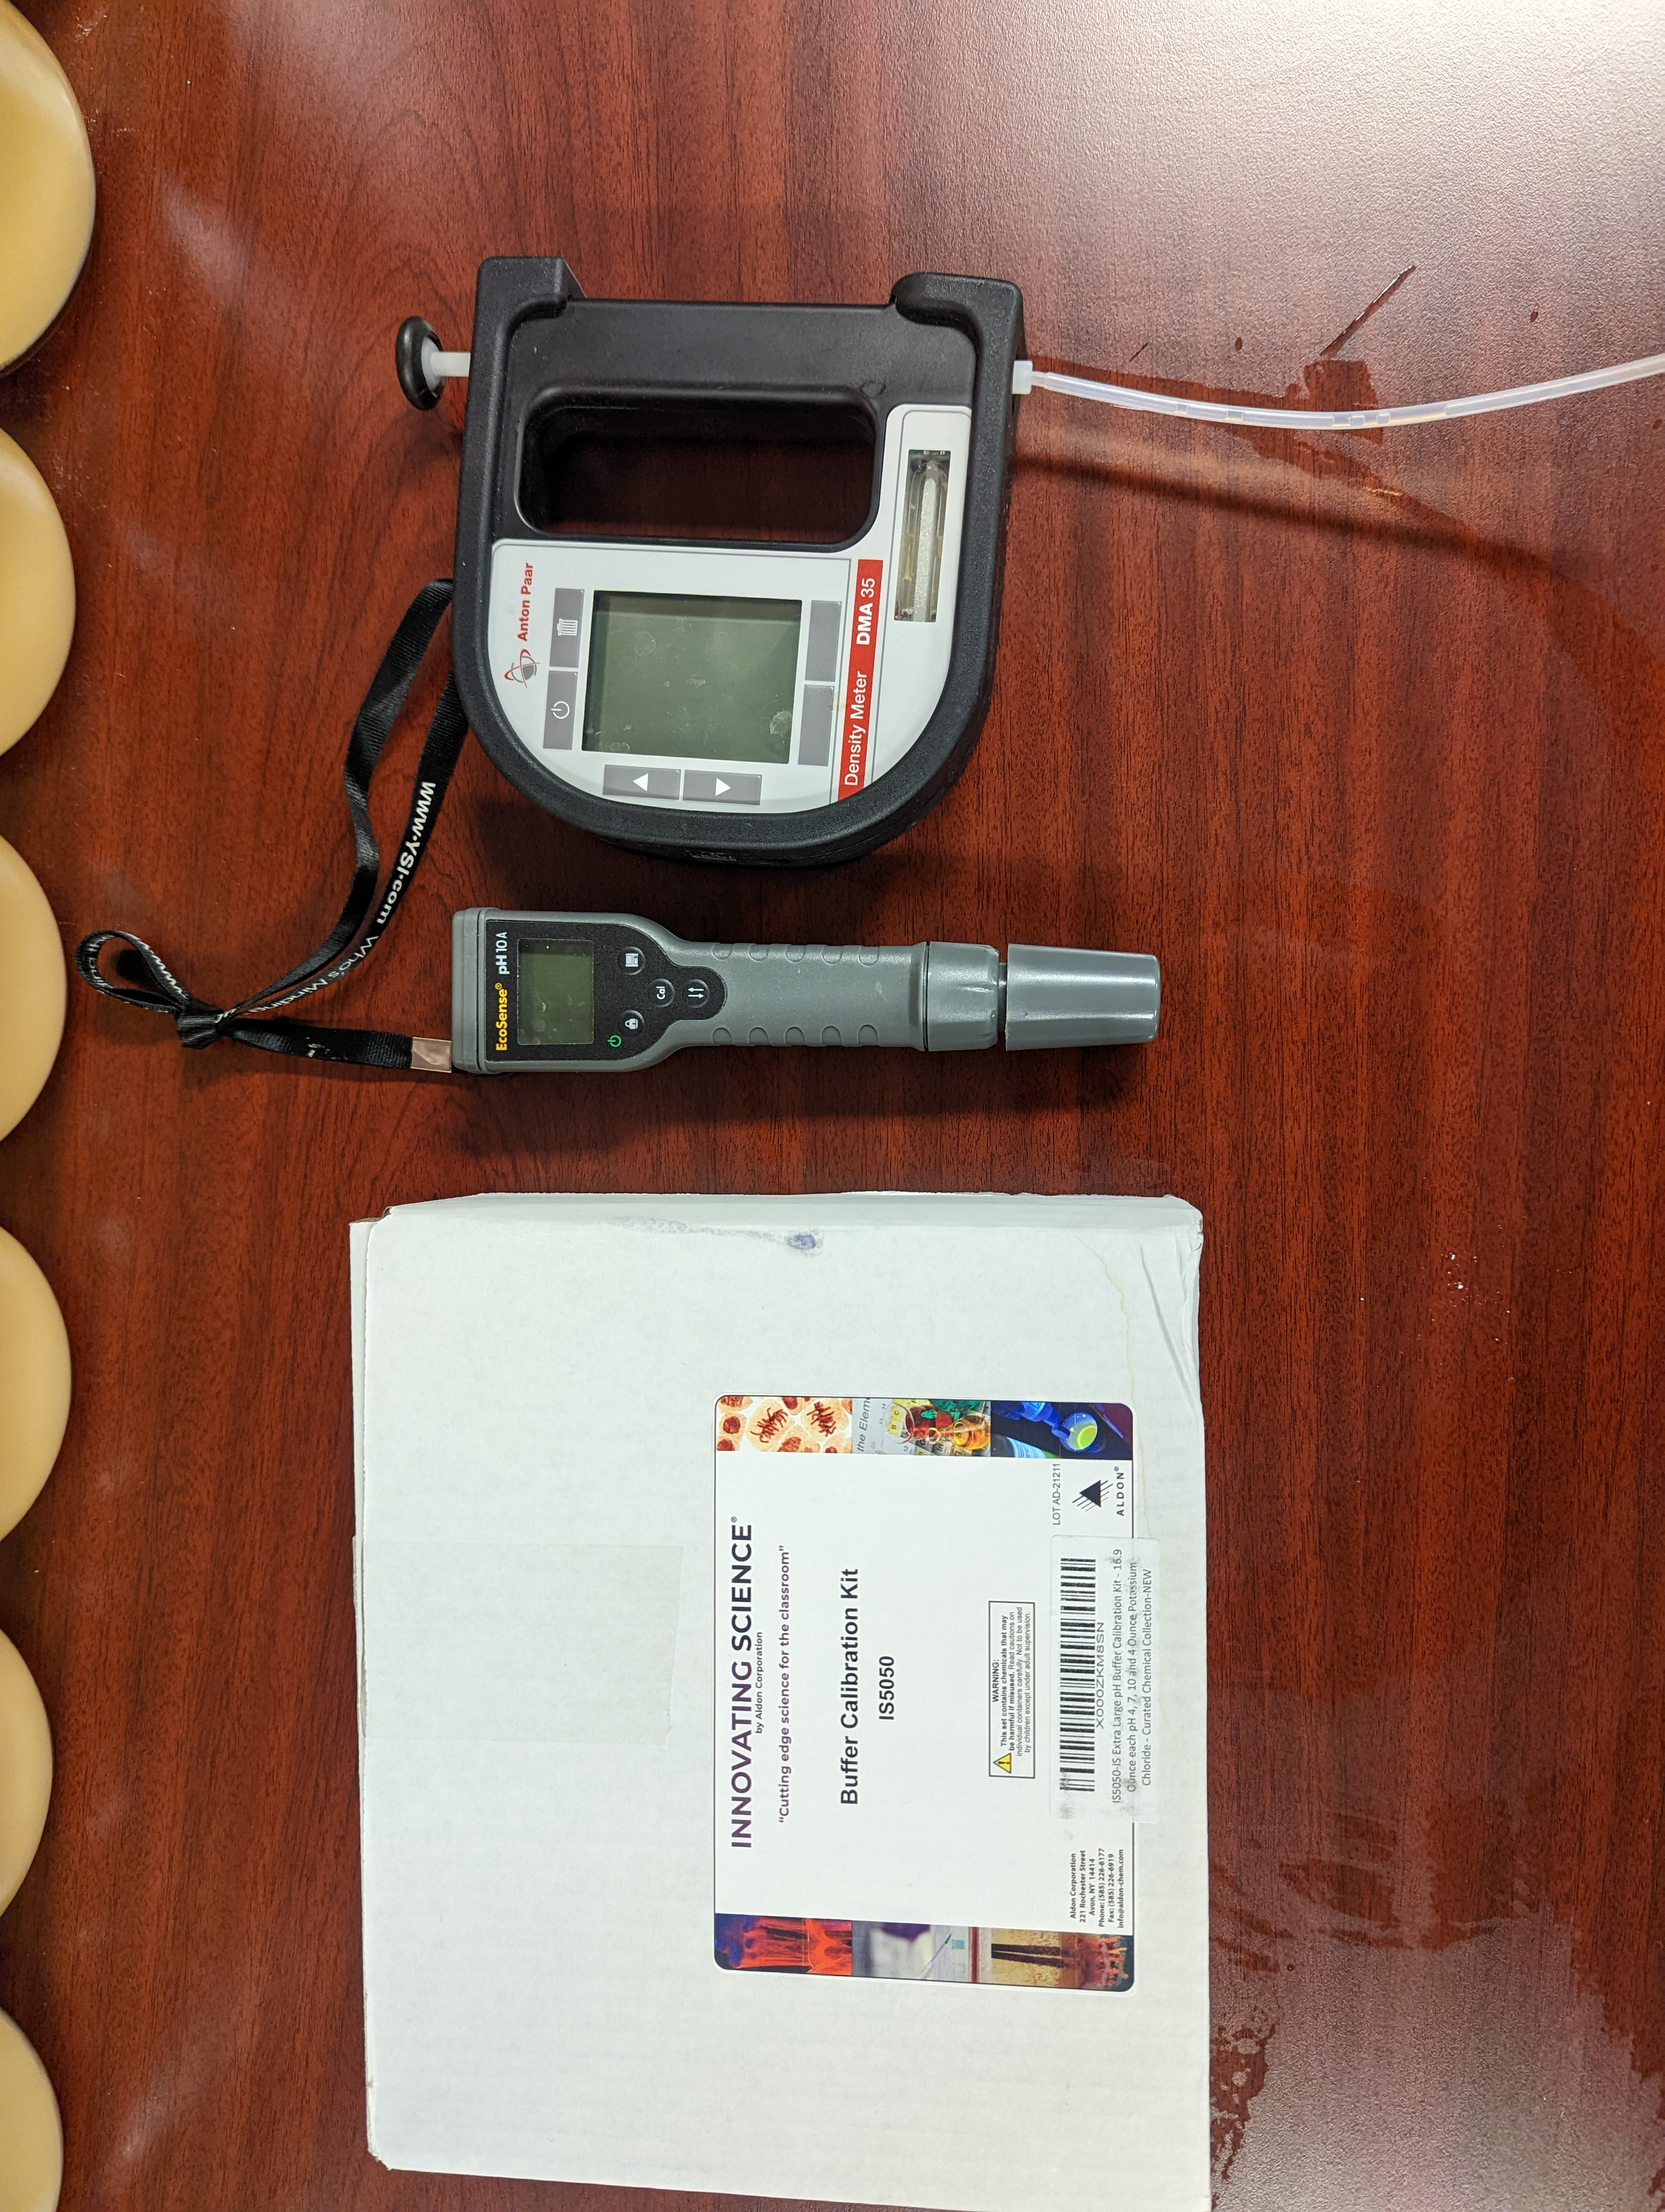
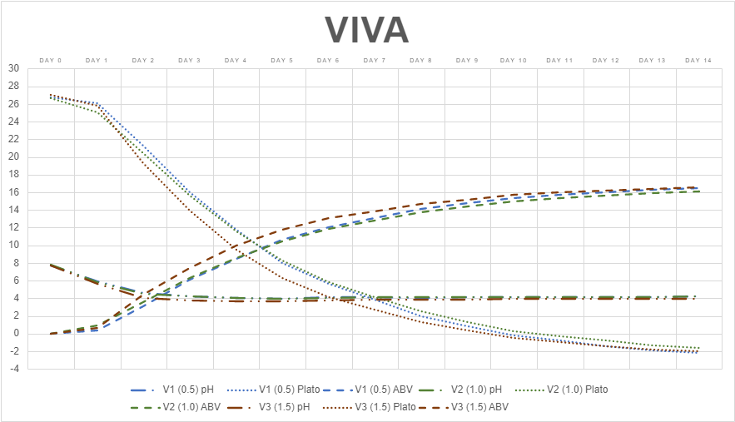
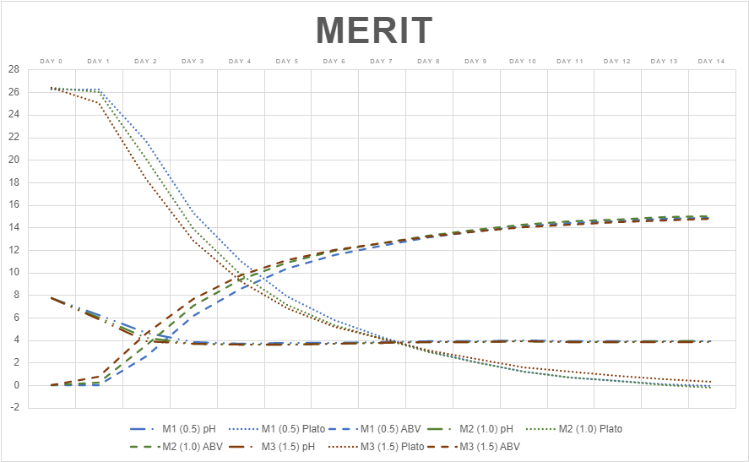
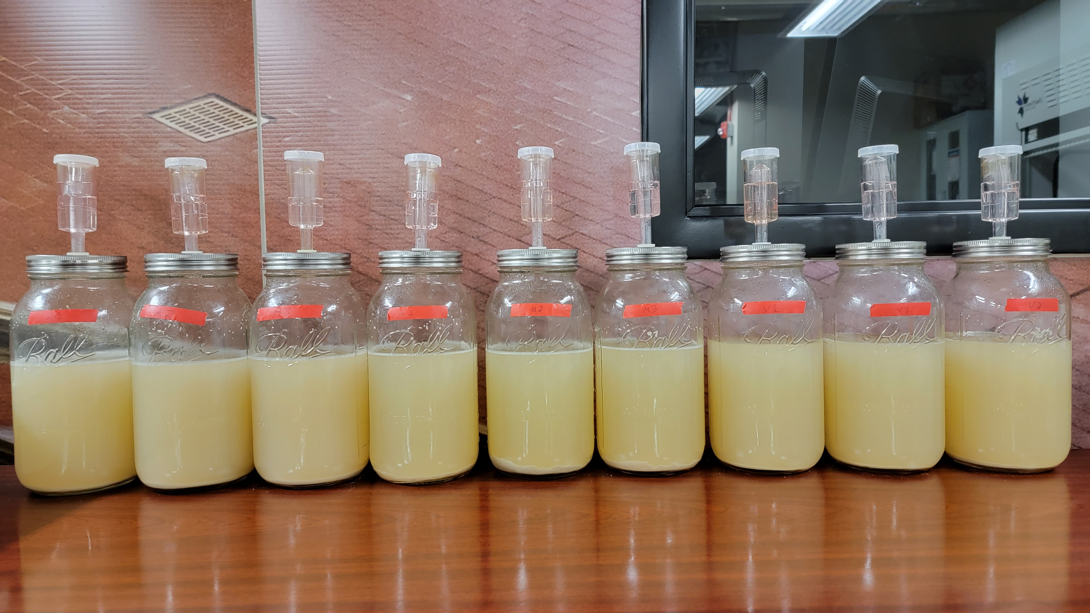
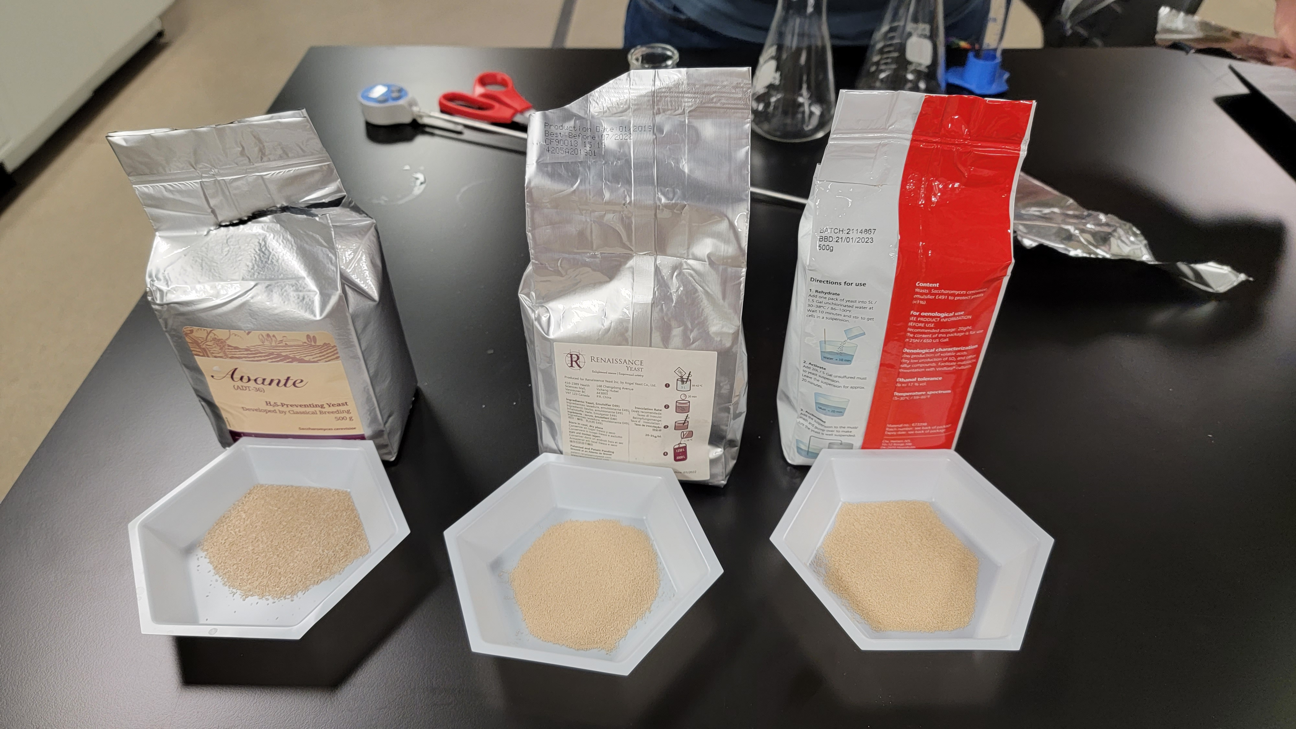
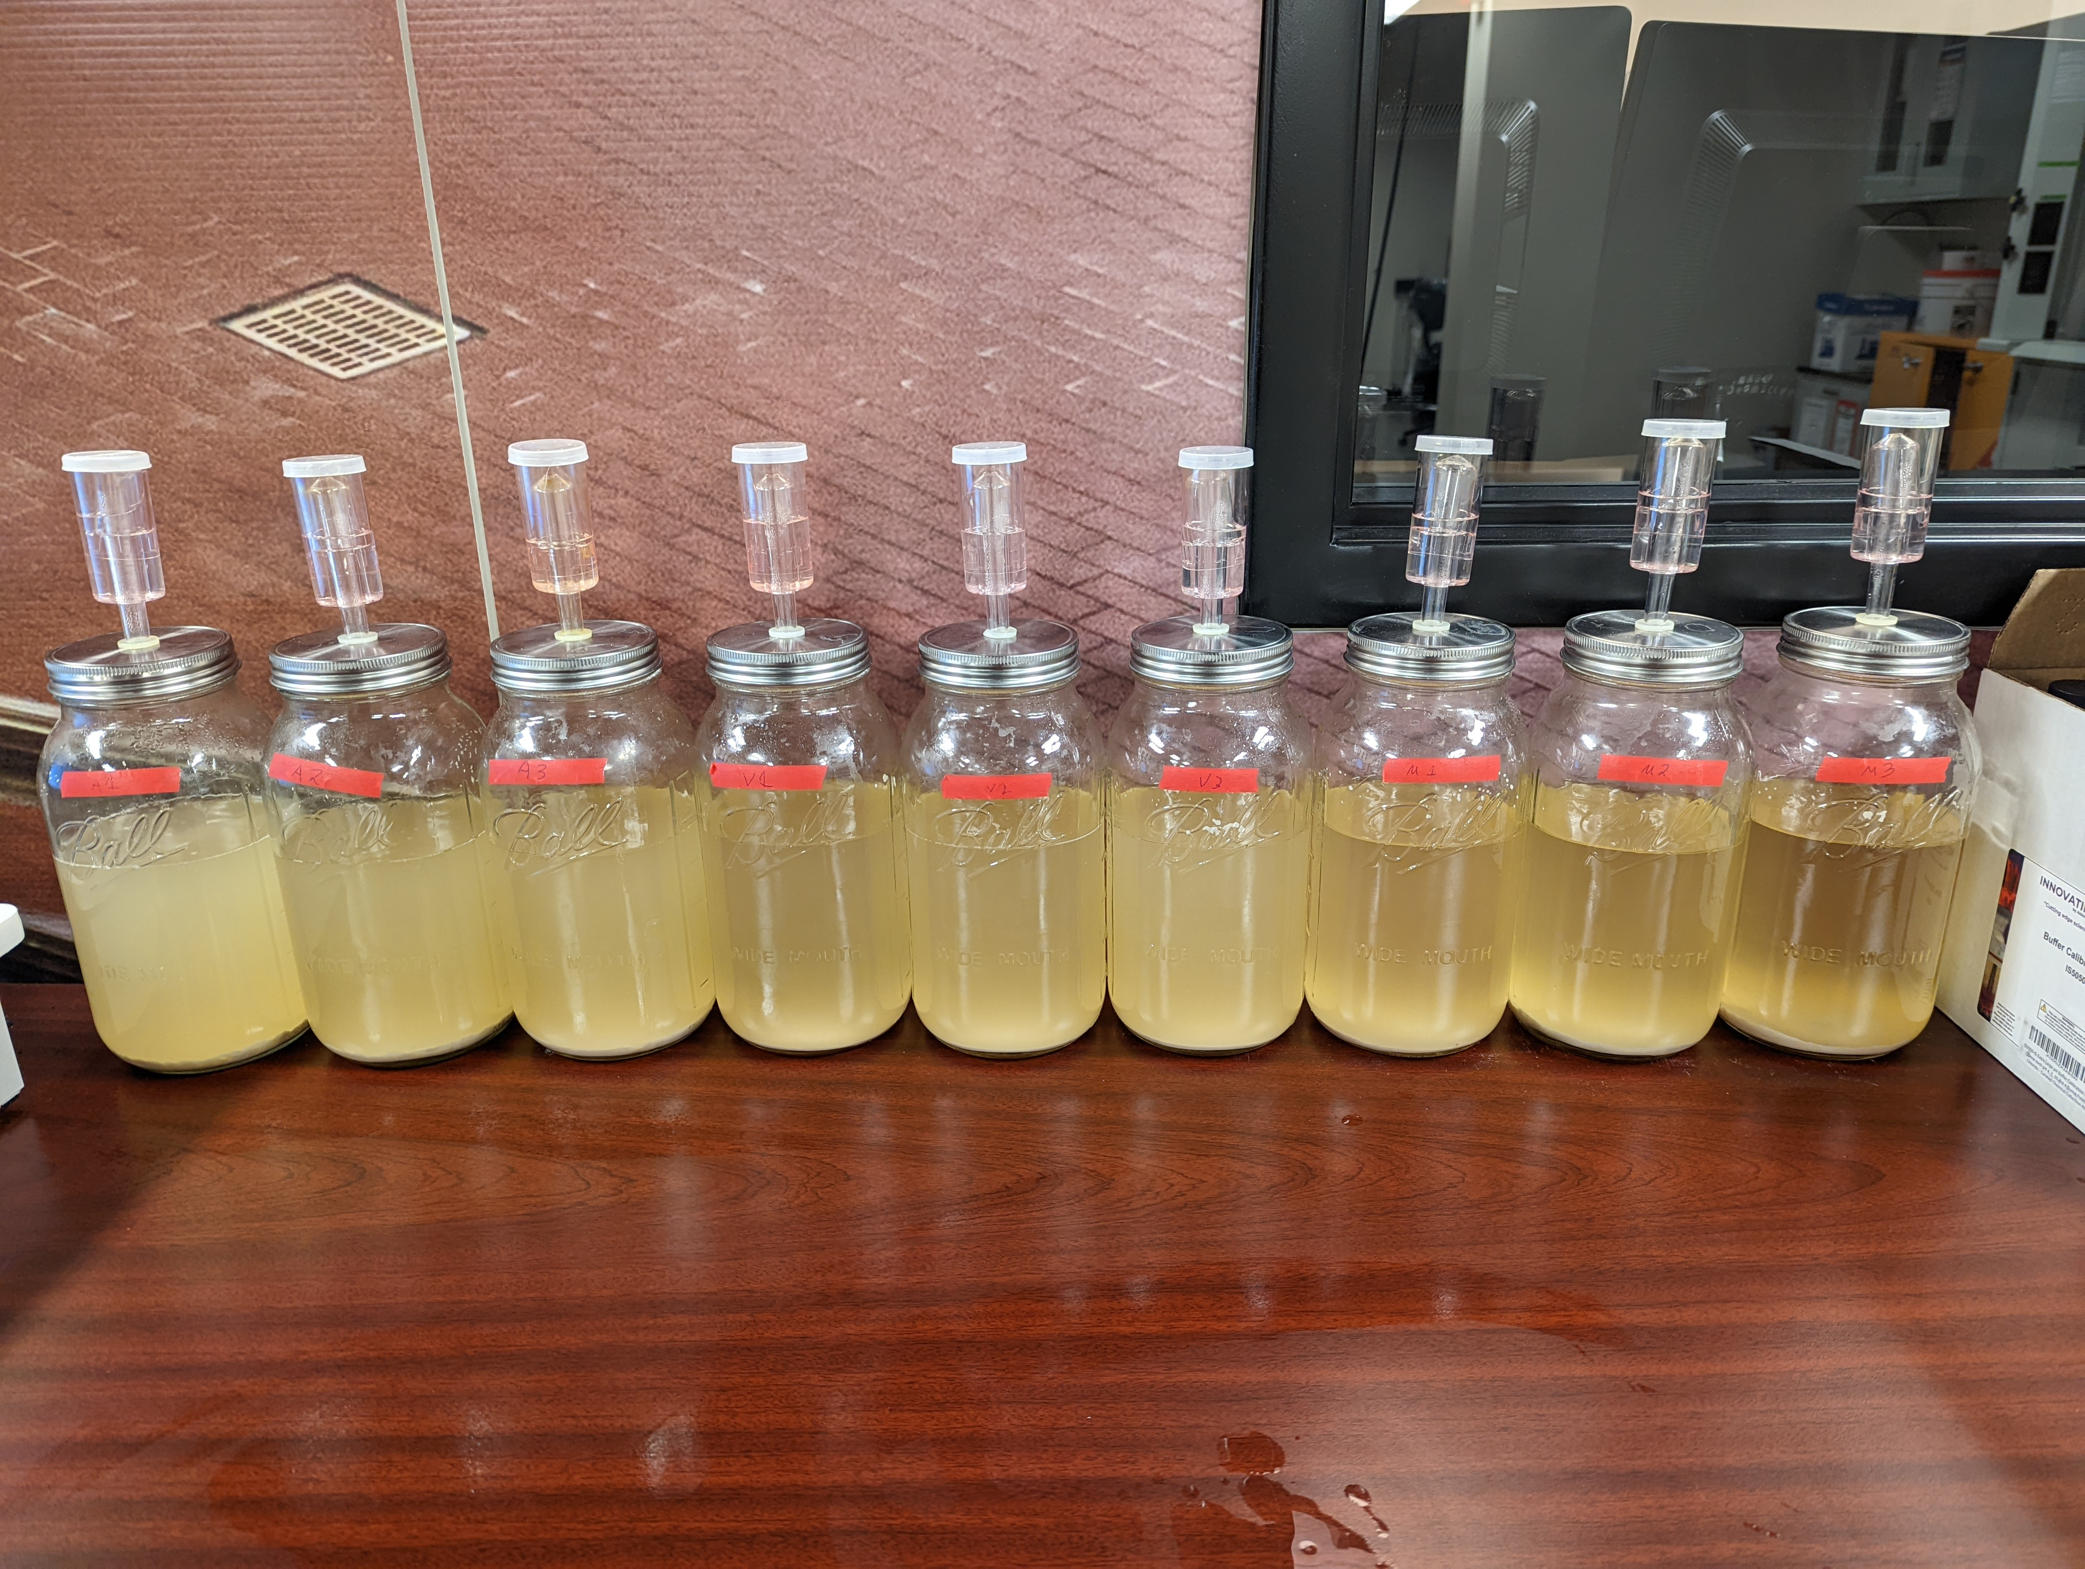
High Gravity Fermentation with Nutrient Supplementation
Abstract
This experiment was meant to test Gusmer Enterprises, Inc’s new seltzer nutrient blend and its performance on different yeast strains as well as pitch rate. As this was a new product, understanding how it performed with different yeast strains was crucial to its use in production spaces. It was already known that nutrient supplementation in seltzer production is necessary however this experiment aimed to define the nutrient’s impact on fermentation with different yeasts and in differing pitch rates.
Water was boiled and 1 liter was added to mason jars containing sugar, nutrient, and trace. The vessels were cooled, mixed and then inoculated with 1 of 3 different varieties of yeast, Merit, Avante, and Viva; in three varying pitch rates .5million cells/ml/degree plato, 1.0million cells/ml/degree plato, and 1.5million cells/ml/degree plato; the lids were sealed and airlocks were added. Over the course of 14 days pH, specific gravity, and temperature were tracked and charted.
pH, and plato drops were noted with all pitch rate samples (A1, A2, A3, M1, M2, M3, V1, V2, V3). Though the larger drops were noted on the 1.5million cells/ml samples of all three yeast (A3, M3, V3). Sample A3 (Avante 1.5million cells/ml) was able to convert sugars to ethanol with nutrient the most efficiently in the 10 day time period.
Background
Very High Gravity (VHG) substrates that are deficient vital nutrients yeast need to grow and multiply.
Nutrients critical to yeast vitality are Free Amino Nitrogen (FAN) sources and other trace minerals, such as calcium and zinc.
The use of nutrient supplement additions into VHG substrates have shown to greatly improve yeast vitality over the course of the fermentation cycle.
Gusmer Enterprises, Inc. have developed a new nutrient, MicroElements Hard Seltzer HG, to be tested with their established yeast strains with variable pitch rates.
Findings
Conclusion
We found that varying the yeast pitch rate with the use of MicroElements Hard Seltzer HG affected the rate of
depletion of fermentable sugars with the yeast strains tested. While pitch rate effected the speed of initial carbohydrate usage it did not impact total fermentation time. Each yeast and pitch rate yielded similar time to completion.
Future Research
Further research with different yeast strains are needed to evaluate the effectiveness of MicroElements Hard Seltzer HG regarding viability and fermentative effectiveness.
Bibliography
Barahona P.P., Martin-Gil J., Martin-Ramos P., Perez A.B., and Barriga E.J.C. “Assessment of the Effect of Nitrogen Concentration on Fermentation and Selection of a Highly Competitive Saccharomyces cerevisiae Strain for Efficient Ethanol Production.” Energies, vol. 12, no. 13, Aug. 2019, pp. 1-12. https://www.mdpi.com/1996-1073/12/13/2614. Betite, V., Júnior, M., Oliveira, J. and Ernandes, J., 2012. Very high gravity sucrose fermentation by Brazilian industrial yeast strains: effect of nitrogen supplementation. Journal of the Institute of Brewing, 118(2), pp.174-178.
Casey, G.P., Magnus, C.A., and Ingledew, W.M. “High-Gravity Brewing - Effects of Nutrition on Yeast Composition, Fermentative Ability, and Alcohol Production.” Applied and Environmental Microbiology, vol. 48, no. 3, Jan. 1984, pp. 639-646. https://europepmc.org/backend/ptpmcrender.fcgi?accid=PMC241579&blobtype=pdf
Ccopa Rivera, E., Yamakawa, C., Saad, M., Atala, D., Ambrosio, W., Bonomi, A., Nolasco Junior, J. and Rossell, C., 2017. Effect of temperature on sugarcane ethanol fermentation: Kinetic modeling and validation under very-high-gravity fermentation conditions. Biochemical Engineering Journal, 119, pp.42-51.
Da Cruz, S.H., Cilli, E.M., and Ernandes, J.R. “Structural Complexity of the Nitrogen Source and Influence on Yeast Growth and Fermentation.” Journal of the Institute of Brewing, vol. 108, no. 1, Jan. 2002, pp. 54-61. https://doi-org.ezproxy2.library.colostate.edu/10.1002/j.2050-0416.2002.tb00124.x
De Almeida, E.L.M., Silva, G.M.E., Vassalli, I.D., Silva, M.S., Santana, W.C., da Silva,P.A., and Eller, M.R., “Effects of nitrogen supplementation on Saccharomyces cerevisiae JP14 fermentation for mead production” Food Science and Technology, vol. 40, June 2020, pp. 336-343. https://www.scielo.br/j/cta/a/xZgF6zc36kdPjrcW9DJBsZr/?lang=en
Li, Z.F., Wang, D.H., and Shi, Y.C., “Effects of nitrogen source on ethanol production in very high gravity fermentation of corn starch” Journal of The Taiwan Institute of Chemical Engineers, vol. 70, Jan. 2017, pp. 229-235. https://www-sciencedirect-com.ezproxy2.library.colostate.edu/science/article/pii/S1876107016304473?via%3Dihub
Puligundla, P., Smogrovicova, D., Mok, C. and Obulam, V., 2019. A review of recent advances in high gravity ethanol fermentation. Renewable Energy, 133, pp.1366-1379.
Puxeu, M., Andorra, I., De Lamo-Castellví, S. and Ferrer-Gallego, R., 2019. Determination of Nutrient Supplementation by Means of ATR-FTIR Spectroscopy during Wine Fermentation. Fermentation, 5(3), p.58.
Younis, O. and Stewart, G., 1999. Effect of Malt Wort, Very-High-Gravity Malt Wort, and Very-High-Gravity Adjunct Wort on Volatile Production inSaccharomyces Cerevisiae. Journal of the American Society of Brewing Chemists, 57(2), pp.39-45.
Methodology
-All vessels, lids, airlocks, and tools were cleaned and then sanitized
-460 grams of sugar, 6.6 grams of nutrient, and .02 grams of trace were added to each vessel
-9 liters of water were boiled and 1 liter was added to each vessel
-Each vessel was then mixed until sugar and nutrient dissolved
-Each vessel was cooled to 25 celsius
-Each yeast was weighed out to hit desired pitch rates
-Each vessel was inoculated with the appropriate yeast and pitch rate
-Each vessel was fitted with a lid, airlock, and left at room temperature
-Data including pH, temperature, and specific gravity was recorded for 14 days
Hypothesis
The effect of increasing yeast pitch rate in a high plato substrate deficient in Free Amino Nitrogen (FAN) and micronutrients supplemented with Gusmer MicroElements Hard Seltzer HG dry yeast nutrient will result in a faster time to complete depletion of fermentable carbohydrates.
Research Question
When utilizing supplementation in nutrient deficient substrates how does pitch rate affect fermentation quality of different strains of Saccharomyces cerevisiae?
Thank you to:
Gusmer Enterprises, Inc.
CSU Fermentation Science and Technology Program,
CHHS
Daniel Gusmer
Eric May
Name | Yeast strain | Pitch rate (million cells/ml/degree plato) | Dry weight (grams)
A1 | Avante | .5 | .79
A2 | Avante | 1 | 1.59
A3 | Avante | 1.5 | 2.38
M1 | Merit | .5 | .39
M2 | Merit | 1 | .79
M3 | Merit | 1.5 | 1.18
V1 | Viva | .5 | 0.57
V2 | Viva | 1 | 1.15
V3 | Viva | 1.5 | 1.72
Authored By:
Jon Denenberg
&
Chance Raynes
Figure 1: Vessel names, yeast strains, and pitch rate

